Slide 1
Day 7 – Model Driven Apps

Slide 2
Content
Actions
Workflow
Plugin development
Custom Workflow and Steps
Q&A

Slide 3
Processes
Process in dynamic 365/Model Drive app are divided in below types
Dialogues (Deprecated, instead we can use Custom Pages)
Action
Workflow (Sooner will be replaced with Power Flow completed)
Plugin

Slide 4
Actions
Actions in Model driven app are created to perform less complexed operations
Actions Can be associated with a single entity or be global
Actions can be created as a part of Business Process Flow
Synchronous in nature and have rollback feature
Can be executed using a JavaScript web resource
Always runs under the security context of the calling user.
Supports auditing of data changes.
Can be invoked directly from a workflow/Web Service
Can have Input and Output parameter which can be used with Plugin or custom workflow to pass or receive process arguments
You can add different steps like workflow to perform synchronous operations
With Action you do below operations
Check Condition , Conditional Branching,
Assigning Value/Record, Create/Update Records
Send Email, Start or Stop Workflow

Slide 5
Workflows
Workflows allow you to automate simple and complex business processes.
You can either create workflows using out-of-the-box functionalities or write custom workflows with .NET code for implementing complex workflows.
Workflow processes run in the background(Asynchronous) or in real-time(Synchronous) and can optionally require a user input.
Workflows are table/entity specific
We can set trigger points for workflow like to start when Record is created, updated, assigned, deleted or when a field changes
Workflows can be part of Business Process flow and can run on demand
Like action we can add multiple steps in workflow as well like below
Check Condition , Conditional Branching,
Assigning Value/Record, Create/Update Records
Send Email, Start or Stop Workflow

Slide 6
Plugin Execution Pipeline
Event | Stage name | Stage number | Description | Sync/Async
Pre-Event | Pre-validation | 10 | Executes before the main system operation and outside the database transaction. | Sync
Pre-Event | Pre-operation | 20 | Executes before the main system operation and executed within the database transaction. | Sync
Platform Core Operation | Main Operation | 30 | This is the actual platform operation. No plugins registered here.
Post-Event | Post-operation | 40 | Executes after the main operation and within the database transaction (if sync). | Sync and Async

Slide 7
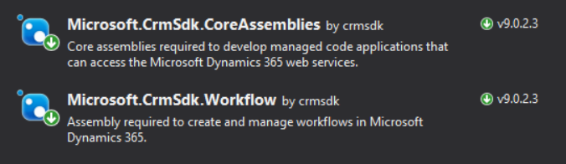
Plugin
If some functionality is not available in out of the box features, we have the option to write Plugin and consume that in the workflow processes
For Writing Plugin below are the general steps we need to follow
Create a .NET Framework Class Library
Add NuGet packages from Package manager
Once NuGet packages are installed then you need to implement an IPlugin interface which will have Execute method
public class DemoPlugin : IPlugin
{
public void Execute(IServiceProvider serviceProvider)
{}
}

Slide 8
Plugin (Continued)
Add Tracing service, plugin execution context interfaces
// Obtain the tracing service to trace the log
ITracingService tracingService = (ITracingService)serviceProvider.GetService(typeof(ITracingService));
// Obtain the execution context from the service provider. IPluginExecutionContext context = (IPluginExecutionContext) serviceProvider.GetService(typeof(IPluginExecutionContext));
To save modified changes to CRM/Model driven app you need have instance of Organization service which can be created as below
IOrganizationServiceFactory serviceFactory = (IOrganizationServiceFactory)serviceProvider.GetService(typeof(IOrganizationServiceFactory));
IOrganizationService service = serviceFactory.CreateOrganizationService(context.UserId)

Slide 9
Plugin (Continued)
You can then add your custom logic inside the Execute method and build the project
Post building it is necessary that you sign the assembly with strong name, and you can do this from project properties
Once you build and sign your assembly you need to open Plugin registration tool to register your assembly
Post registration you can add different plugin steps in plugin registration tool and build your logic

Slide 10
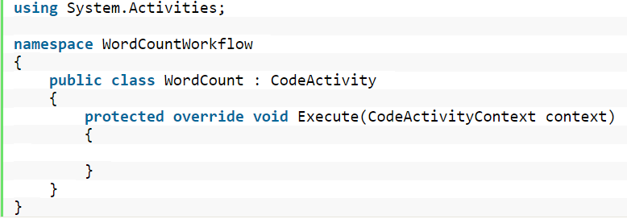
Custom Workflows
If some functionality is not available in out of the box features, we have the option to write Custom Workflow Activity and consume that in the workflow processes
For Writing Custom workflow below are the general steps we need to follow
Create a .NET Framework class library project
Add NuGet packages from Package manager
3. Once NuGet packages are installed then you need to implement an abstract class CodeActivity which will have Execute method

Slide 11
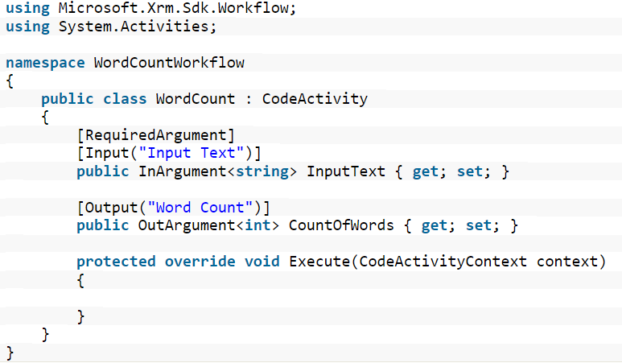
Custom Workflows (Continued)
4. Add Input/Output Arguments
You can then add your custom logic inside the Execute method and build the project
Post building it is necessary that you sign the assembly with strong name, and you can do this from project properties
Once you build and sign your assembly you need to open Plugin registration tool to register your assembly
Post registration you can add different workflow steps in plugin registration tool and build your logic
And At last, you need to create an OOB workflow and have to add custom workflow as a workflow step in CRM

Slide 12
Custom API
Custom API let you to expose your application entities to 3rd party and vice a versa. There are below ways to develop custom API’s
Using Plugin Registration Tool
Using Power Apps GUI
Azure App Services
With Code (Web API/WCF Service)

Slide 13
Steps for Custom API
In Power apps Dataverse you can add new solution component as Custom API, Custom API Request and Response Parameters
Request parameter will be input for your application and Response will be kind of success/failure acknowledgement
We can trigger the custom API through Plugin, custom workflow, OOB workflow or JavaScript
If we use Plugin, then we don’t need to register any steps for plugin we will just register the assembly.
In the assembly we will pass the input parameters to our Custom API and if required will update respective entities using Organization Service
Once assembly is loaded in plugin registration tool we will have to link the plugin in the Dataverse Custom API entity we created
Once Custom API from Dataverse is linked to plugin we created then its time to go for generating authentication token and register our app
To generate an authentication token we need to go in the azure portal, we can navigate it from Admin center of power apps and then in Azure Active Directory settings

Slide 14
Steps for Custom API
9. In Azure portal click on App Registration, select account type(Single/Multi tenant), callback/Redirect URL etc.
10. Once App is register it will generate a client/app Id which will be used for authentication
11. Along with app registration you will also need to add permission for platform like D365 or Power app services.
12. Once these settings are done then you can use these details to authenticate the API through Web API custom code from 3rd Party

Slide 15
Fetch Xml and Query Expressions
Fetch XML is an XML type query language which gets internally used to fetch the CRM/Dataverse Entities
You can Select entity, attributes, can link entities, can add filter conditions as well.
XRM toolbox also has a Fetch XML builder tool
We can use Fetch XML in code behind (In plugin/JavaScript) to get the CRM/Dataverse data
Query Expression also as similar features but it is better in performance and has syntactical differences
Refer below link for more details
https://docs.microsoft.com/en-us/power-apps/developer/data-platform/use-fetchxml-construct-query
https://docs.microsoft.com/en-us/power-apps/developer/data-platform/org-service/build-queries-with-queryexpression

Slide 16
Thank You

